Slide 1
Using Reinforcement Learning and Algorithmic Techniques to Develop Strategies for Tournament-Style Backgammon Matches
Will Farmer
Computer Science (Level 3)
9/12/2024

Slide 2
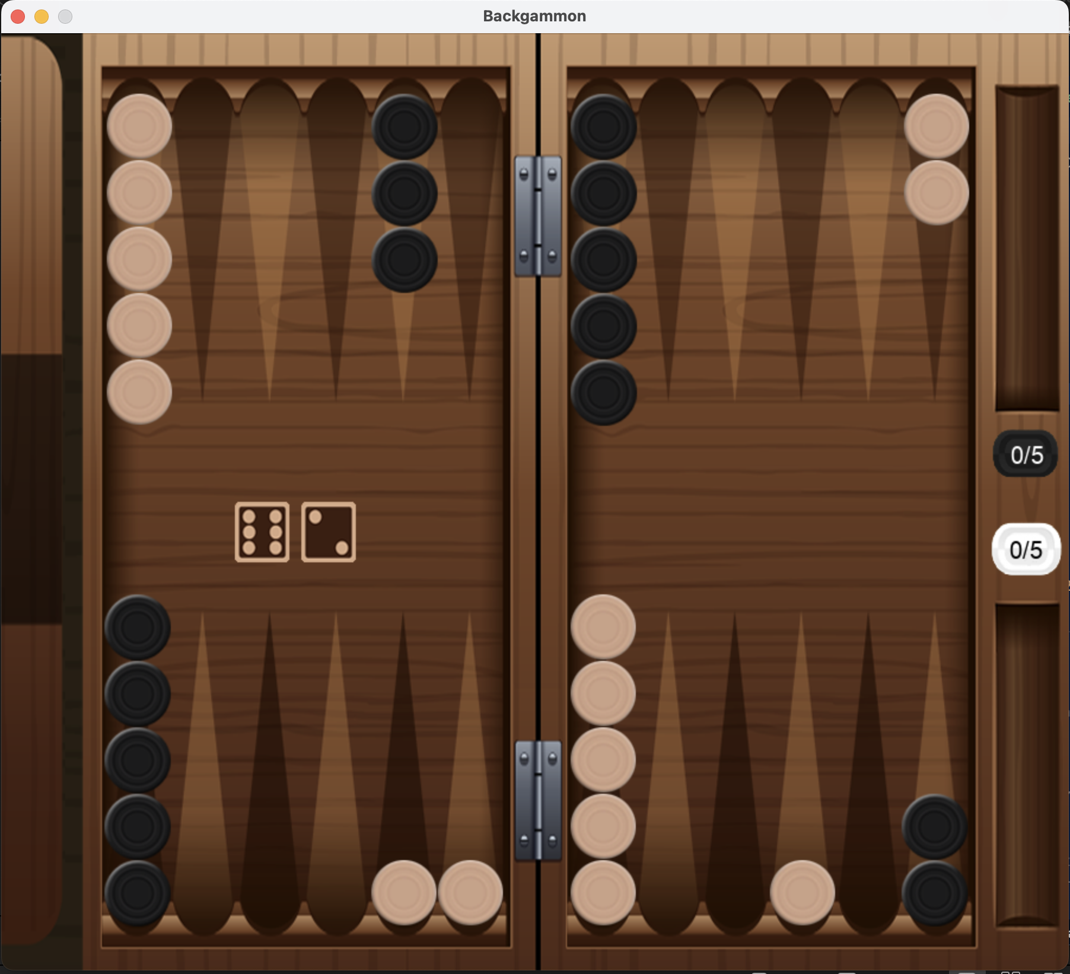
What is Backgammon?
A Two-player zero-sum probabilistic game
Both players attempt to move their pieces around the board into their ‘home’
First player to move all their pieces into their home and bear the pieces off the board wins
Moves are dictated by the dice rolls

Slide 3
Definitions
Pieces can be “hit” off the board
The player must get their piece(s) back on the board before doing anything else
Must enter from the very start!
A “blot” is a single piece occupying a point on the board
Only blots can be hit off
An “anchor” is any piece that isn’t a blot
A prime is 4 or more anchors occupying consecutive points
“Pip Count” refers to the total distance all of a player’s pieces need to move before they win the game

Slide 4
Motivation
All popular backgammon algorithms focus on winning individual games
Backgammon is played in a first-to format, where the victor is the first player to reach the score limit
You can strategize for a better point return by using the Doubling Cube, or aiming to win by gammon or backgammon, which yield additional points

Slide 5
Motivation
Tesauro’s TD-Gammon is almost 20 years old and is still the leading Backgammon AI
A reinforcement learning model focused on winning individual games
Uses heuristic doubling algorithm
Model didn’t include information about backgammons
Do agents designed to maximise PPG differential instead of win rate perform better in tournament-style matches?

Slide 6
Deliverables
Basic
Random Agent
Robust Game Environment
Graphical User Interface (GUI)
Intermediate
Greedy Agent
Genetic Agent
Expectimax Agent
Advanced
Reinforcement Learning Agent
Machine Learning Agent
Agent that changes strategy based on state of the game

Slide 7
Robust Game Engine
Critical to ensure the deep learning and reinforcement learning agents are trained on accurate rules of the game so that they don’t make illegal moves
Allows the simulation of real-life backgammon games
Allows for direct comparison between different agents
Confirmed by viewing and playing hundreds of games with no illegal moves or errors

Slide 8
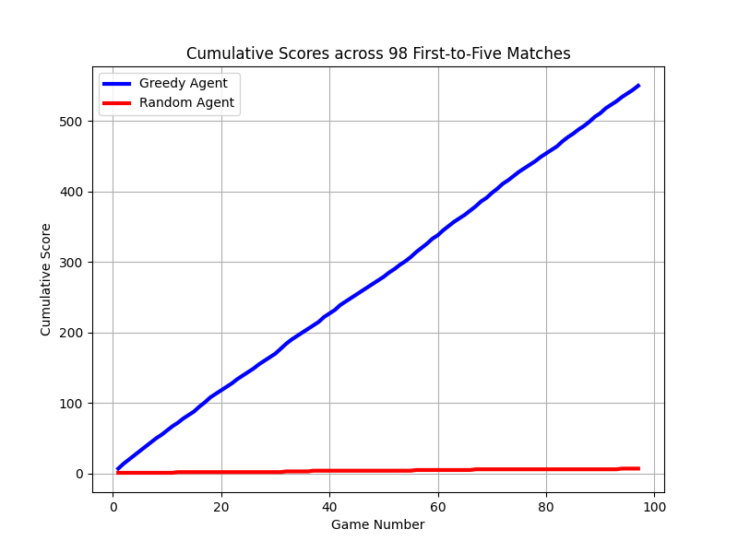
Random Agent
Generates random integers until they form valid moves
Developed to test the robustness of the game engine and provide a beginner-level opponent for user and baseline testing
Helped locate errors with rolling doubles, entering and bearing off
Loses convincingly against any opponent
Final Score: 545-0
Rounded Average score: 6-0

Slide 9
GUI
Extremely useful for viewing games and analysing decisions
This has been vital in debugging various issues with agents
Especially with the Greedy Agent
Allows humans to play agents without knowledge of backend program, paramount for user testing
Allows for direct comparison between different agents

Slide 10
Greedy Agent
Scores each possible resulting board
Utilises 17 hard-coded weights and nested conditional statements
In the case where multiple resulting boards have the same score, a tiebreaker occurs.
Tiebreaker was introduced to remedy unintended bias
Always chooses the predefined best move
No lookahead
Completed before all other intermediate deliverables
They would require features present in the Greedy Agent’s code

Slide 11
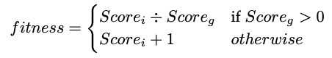
Genetic Agent
All the nested conditions from the greedy agent were flattened
Initial population has randomly generated weights
Fitness is determined by first-to-five matches of the individual vs the greedy agent:
All individuals with a fitness greater than 5 then coevolve against each other in first-to-25 matches until only one remains.
Remaining individual is then chosen to be the genetic agent

Slide 12
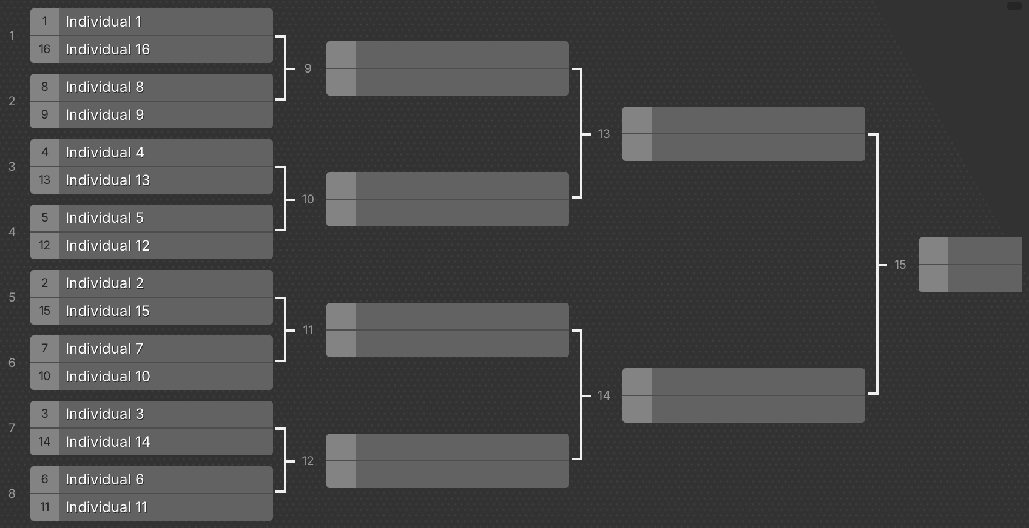
Single-elimination First-to-25 tournament. Winner chosen as Genetic Agent.

Slide 13
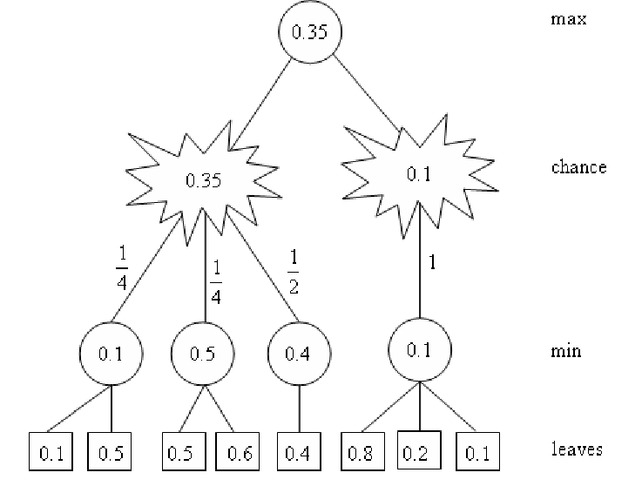
Expectimax Agent
The agents checks which move is theoretically worst for the opponent and plays it
Uses the greedy agent’s evaluation function to score each of the opponent’s possible follow-up moves
Then chooses the move that minimizes the score of the opponent’s follow-up
Tree from perspective of the AI

Slide 14
Comparison of Intermediate Agent Performance
Expectimax vs Greedy across 5000 games
2436-2574 wins.
Expectimax vs Genetic across 1000 games
431-569 wins
Genetic vs Greedy across 10,000 games
5478-4522 wins
3157-3898 final score
567-898 final score
7401-6068 final score

Slide 15
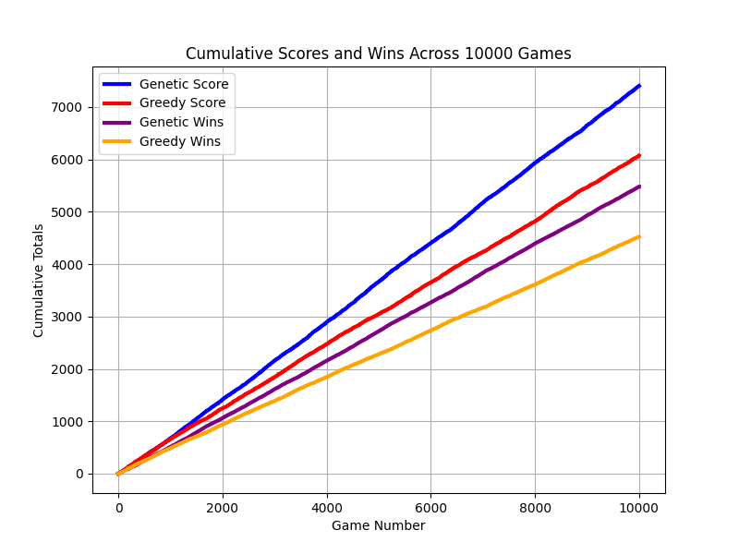
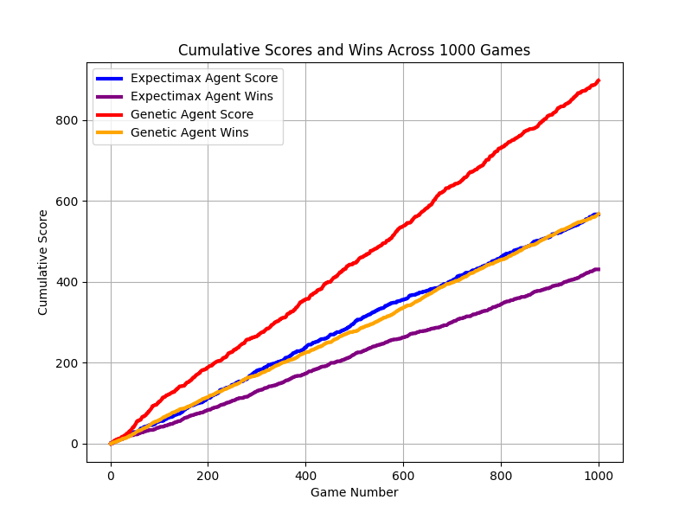
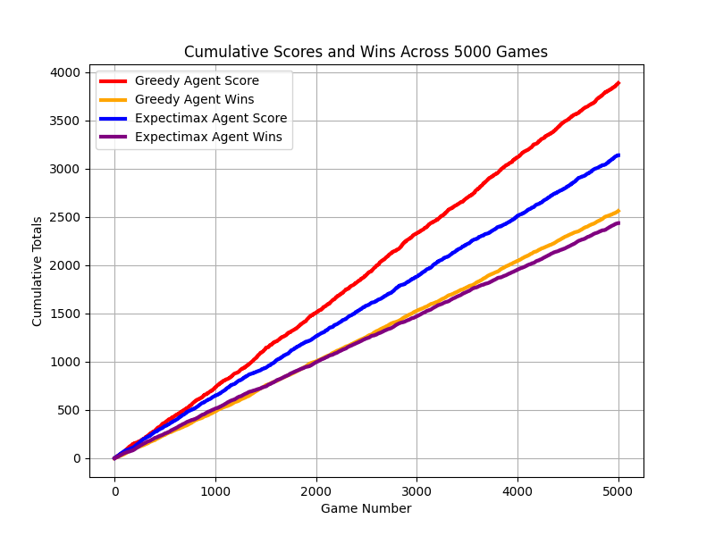
Visualisation of Head-to-Head Results
Genetic vs Greedy
Genetic vs Expectimax
Greedy vs Expectimax
Genetic agent +0.133ppg
Genetic agent +0.331ppg
Greedy agent +0.148ppg
Genetic wins 54.8%
Genetic wins 56.9%
Greedy wins 51.5%

Slide 16
Adaptive Agent
Utilises different strategies at different phases of the game
Turn 1 uses the Greedy evaluation function
In a bear-off race uses Matussek’s game-winning-chance formula for optimally bearing-off and positioning checkers
If high risk of being gammoned, moves furthest piece back
Otherwise uses 30-parameter equity calculation to board strength and game-winning-chance
If equity tie, uses one-move lookahead to probabilistically make best move
Notes:
https://bkgm.com/articles/Matussek/BearoffGWC.pdf?utm_source=chatgpt.com

Slide 17
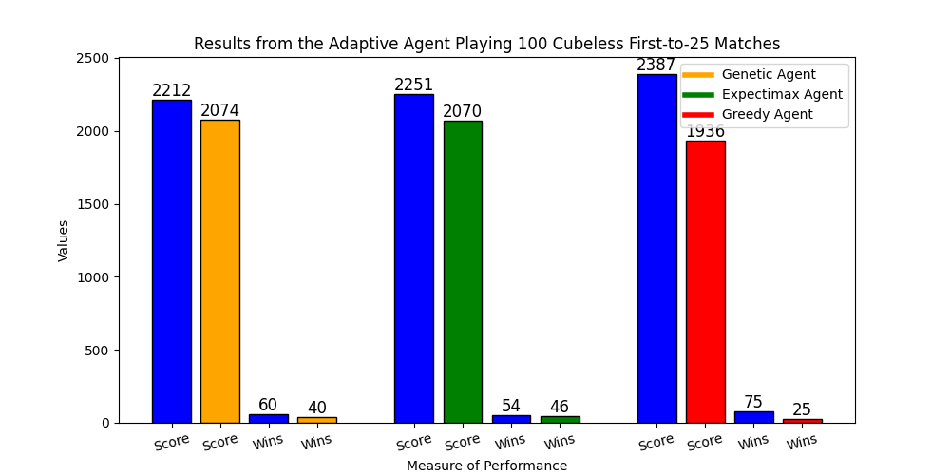
Performance of the Adaptive Agent

Slide 18
Adaptive Agent Doubling
Uses a combination of theoretical formulae and genetic methods to make doubling decisions
Played hundreds of games against the intermediate agents and identified which doubling points maximized PPG differential
To improve generalizability another co-evolution tournament took place to identify which of the high-performing doubling points were the best
When in a race position, the agent uses Keeler and Spencer’s optimal doubling points in conjunction with Matussek’s regression formula

Slide 19
Deep Agent
Utilises Deep Neural networks
Trained using Supervised Learning on expert preferences
GNUBG
Was initially trained to output an estimated value for the state on Mean Squared Error loss
Small inaccuracies led the model to perform poorly in practice even with low MSE loss
Later trained to output a preference between two board states and was trained on Binary Cross Entropy loss
Huge increase in performance

Slide 20
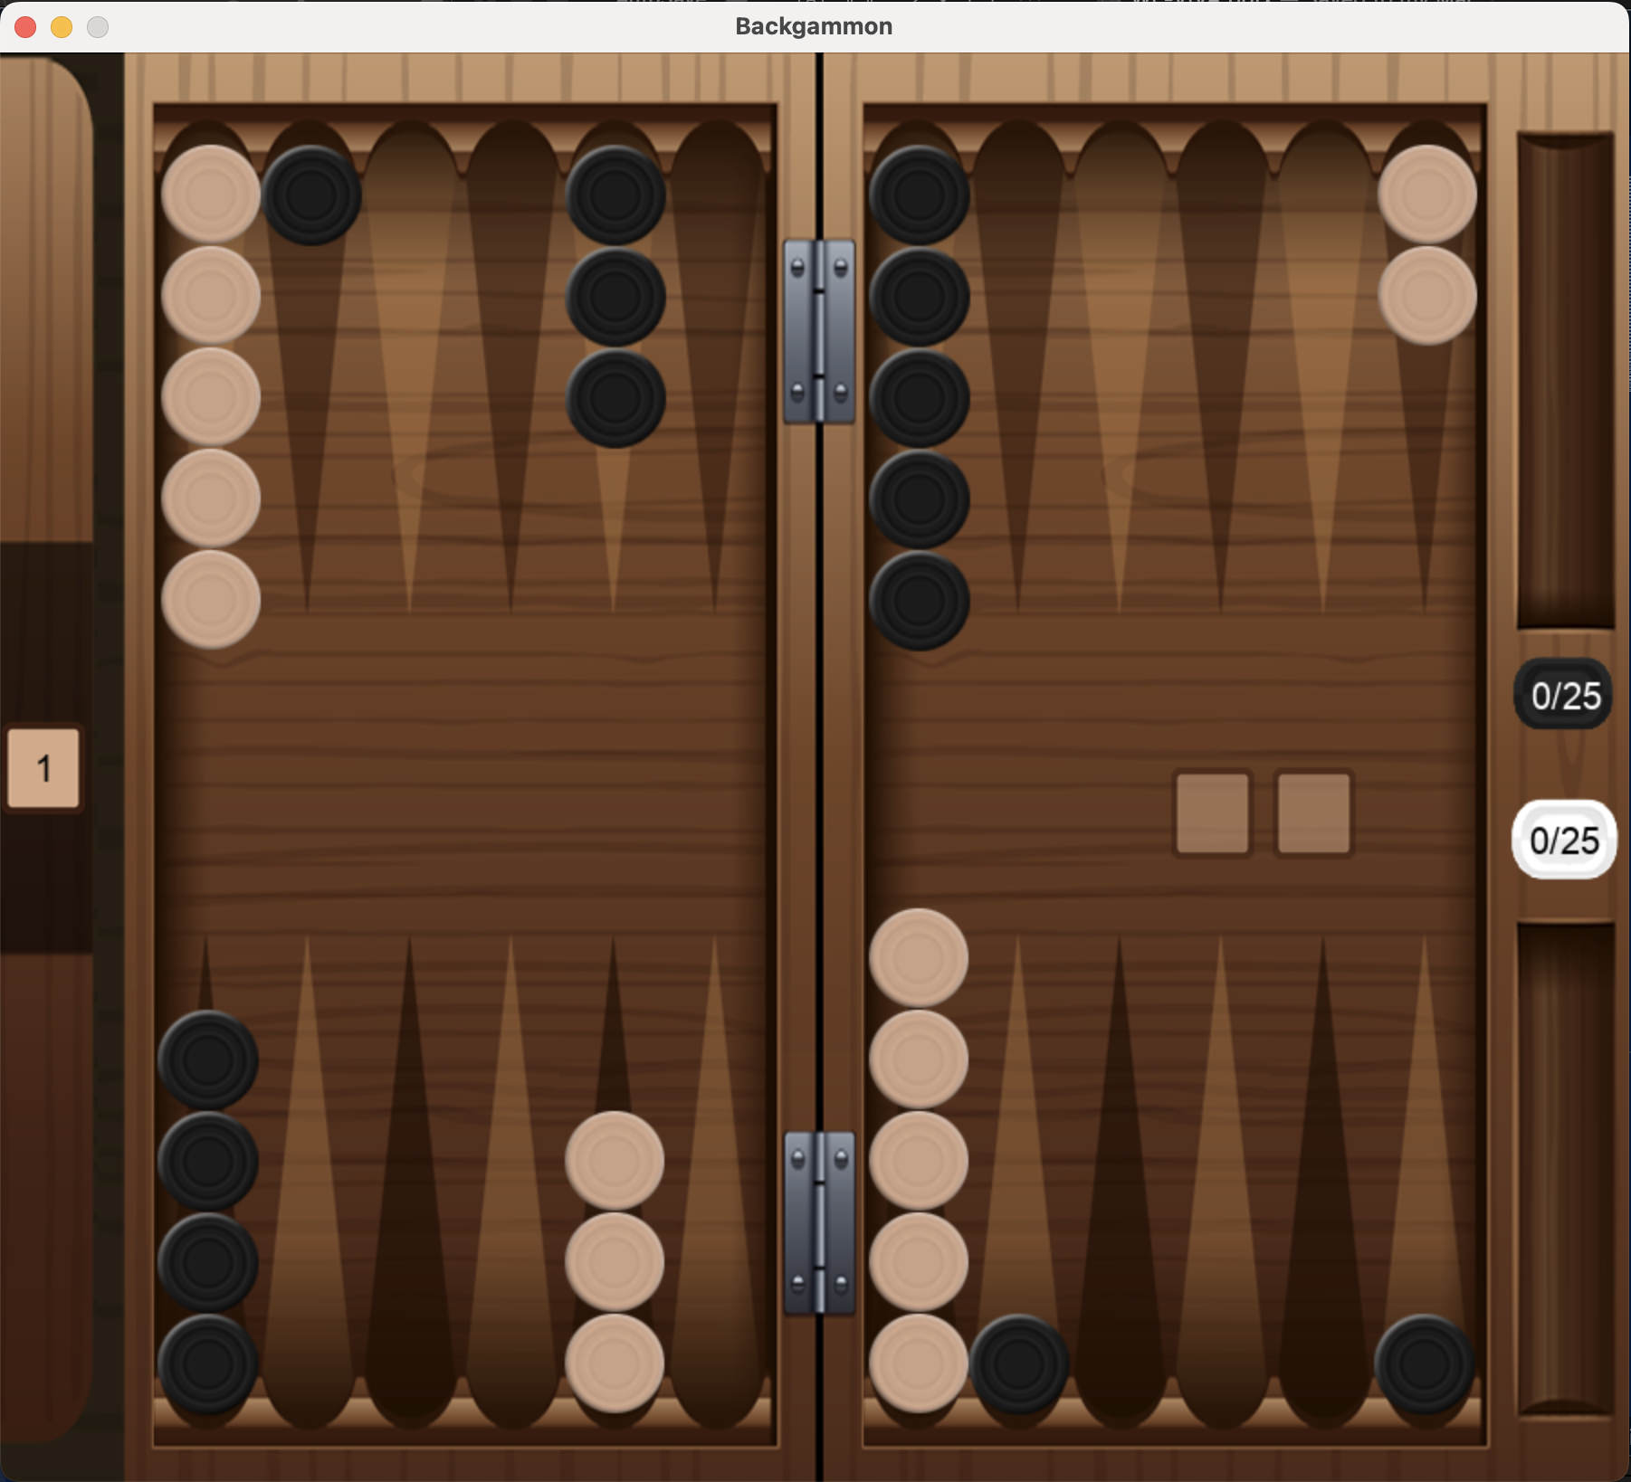
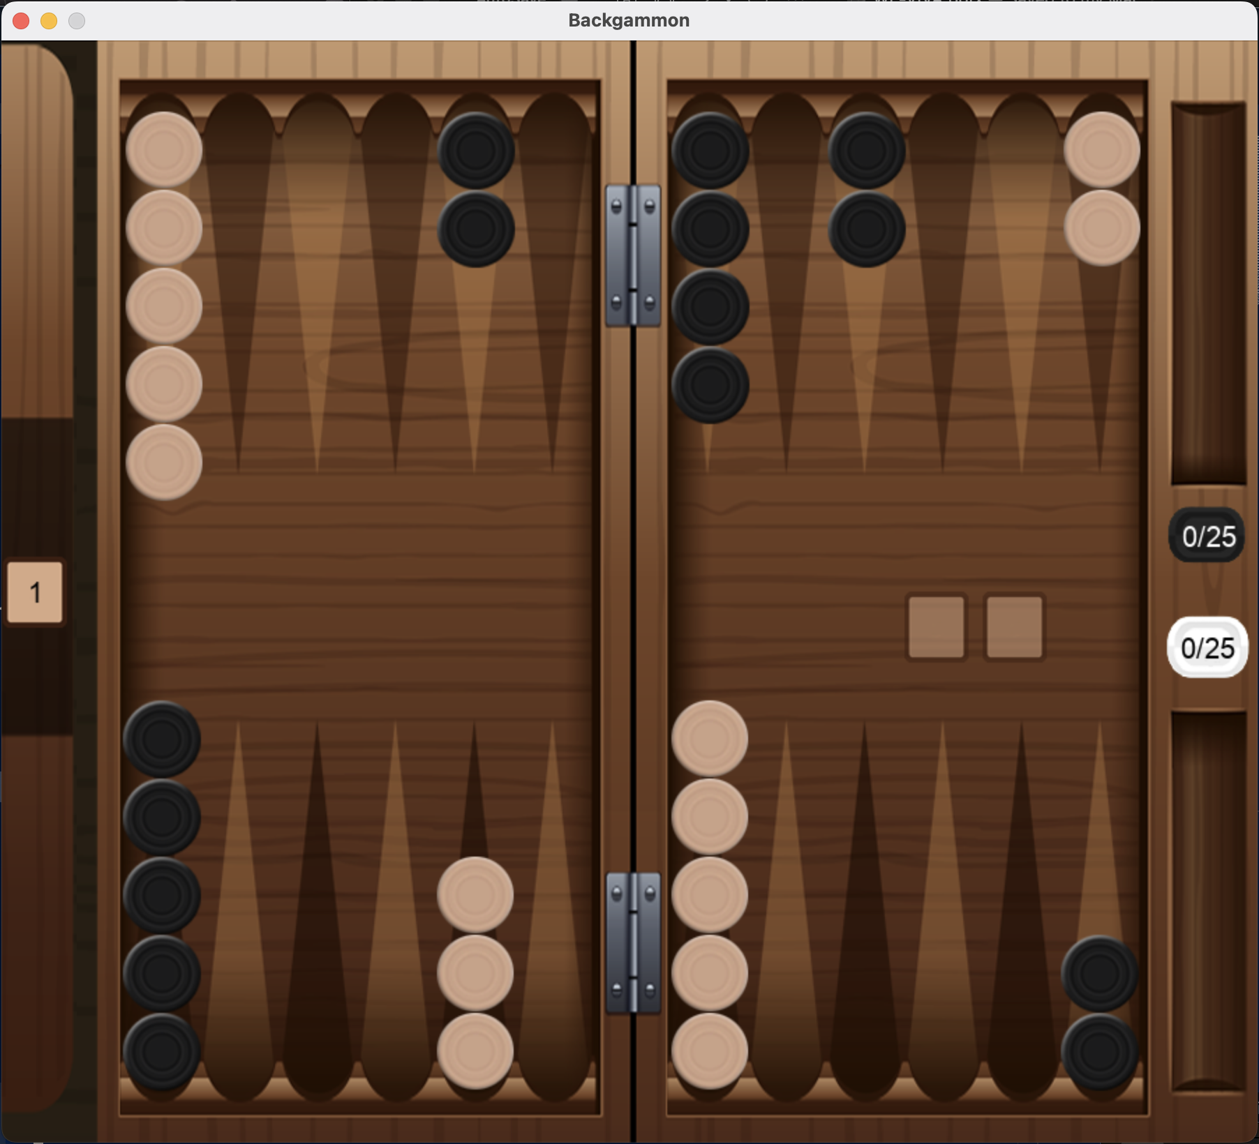
W₁ = W₂
W₁
W₃ = -W₄
W₃
Output preference
Encode Boards
Extract features
W₄
W₂

Slide 21
Deep Agent Iterations
Version 1 Initially had 1 general-purpose model but had identifiable weaknesses
1
Version 2 was trained for an additional 100 epochs
2
Versions 3 and 3.5 contained 3 specialist networks
3
Versions 4 and 4.5:
4
3 networks for different types of position
Initial general-purpose network for contact positions
Bear-in network for getting pieces home when in a race
Bear-off network for bearing pieces off the board when home
Couldn't tell difference between race and contact positions
Didn't understand value of bearing pieces off
Decrease in performance as model overfitting to training set
Performance decreased as contact specialist could not plan ahead

Slide 22
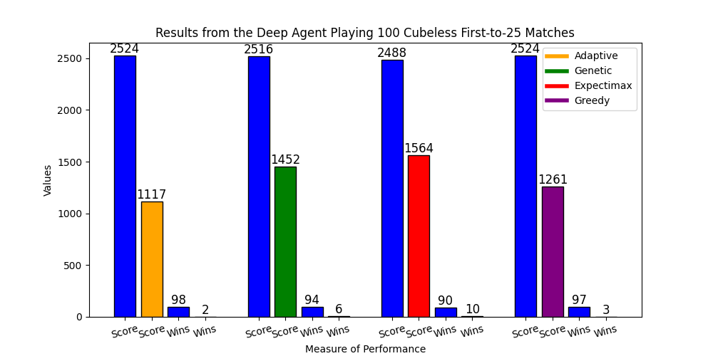
Deep Agent Head-to-Head Performance

Slide 23
Deep Agent vs State of the Art
Neurogammon is the state of the art for supervised learning backgammon-playing programs and won the 1989 Computer Olympiad
The Deep Agent dramatically outperforms Neurogammon in bear-in and bear-off positions but is slightly less accurate in contact positions
Majority of positions in backgammon are contact
Position | Deep Move Accuracy | Neurogammon Move Accuracy
Contact | 66% | 69%
Bear-in | 80% | 63%
Bear-off | 95% | 83%
Accuracy of the AIs on unseen board states

Slide 24
Potential Improvements to Deep Agent
Makes mistakes when it sees its guaranteed to win or lose
Was trained on expert-generated equities
When it thinks its guaranteed to lose, it effectively gives up
Sometimes loses by backgammon when could have easily just been a gammon
Retrain model on equities that factor in (back)gammons
Blunders on two of the best opening rolls
Could make a specialist opening move network
Could even just hardcode the best move to play as there are only 15 possible opening rolls
Most opening rolls are accurate though

Slide 25
Deep Agent Doubling
Models | Structure | Description | Justification
Contact Accept + Offer | 291-12-1 | Same board state and precomputed features as move-selection networks. Added units represented number of borne off pieces for each player. | Binary classification task Explicit representation of borne-off pieces as network would sometimes choose to double even if opponent has borne off many more pieces
Race Accept + Offer | 265-12-1 | Same as Contact networks except removed all precomputed features that are only relevant to contact position | Success with contact models Many of the precomputed features are irrelevant in a race so were removed to prevent distraction and computation time

Slide 26
Reinforcement Agent
Uses Temporal-Difference(lambda) learning
Trained in hundreds of thousands of games playing against itself
Rudimentary board encoding without any precomputed features
Uses 2-ply selective lookahead to minimise the impact of counterplays while maximising equity
Uses Deep Agent’s doubling strategy
Calculates an expected value by estimating the probability of each terminal state occurring and chooses the move that maximises this value

Slide 27
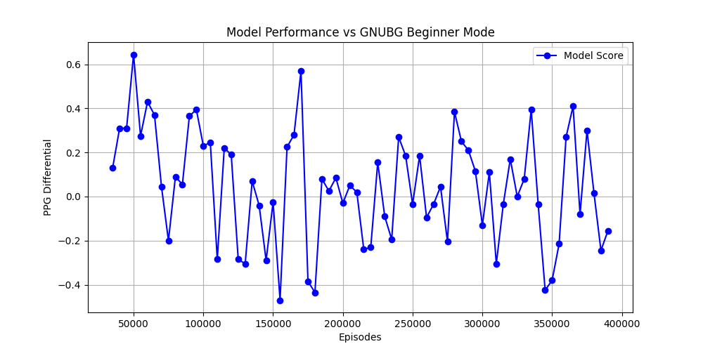
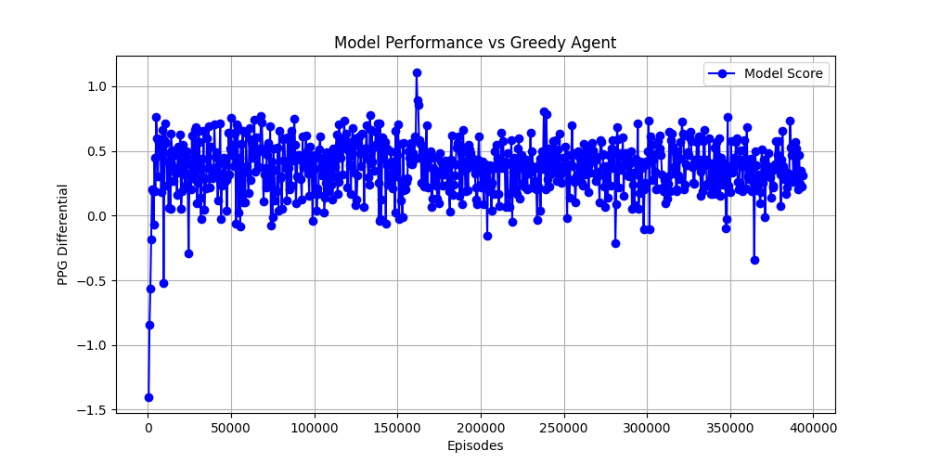
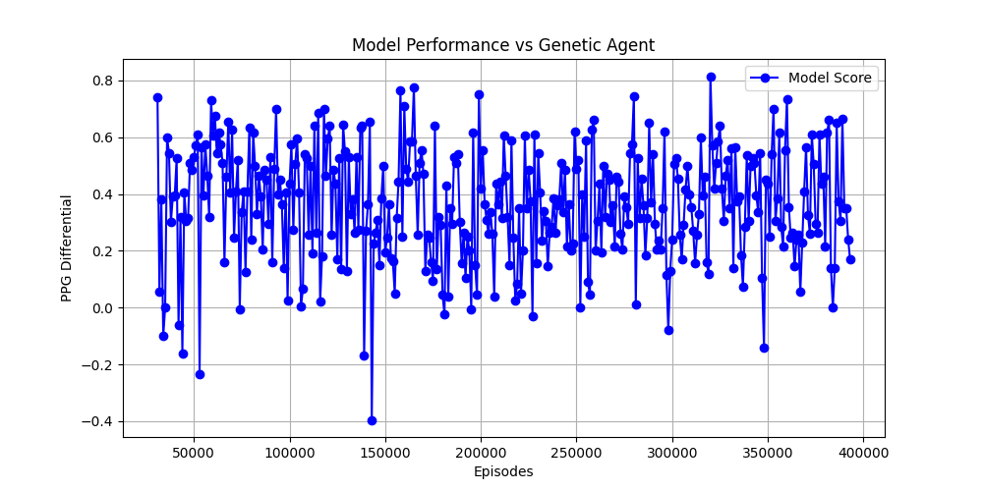
Training the Reinforcement Agent
Action (move) selected always according to the policy
Self-play
No lookahead in training to reduce computational cost
Regularly benchmarked
Reward equal to points won/lost at the end of an episode (game)

Slide 28
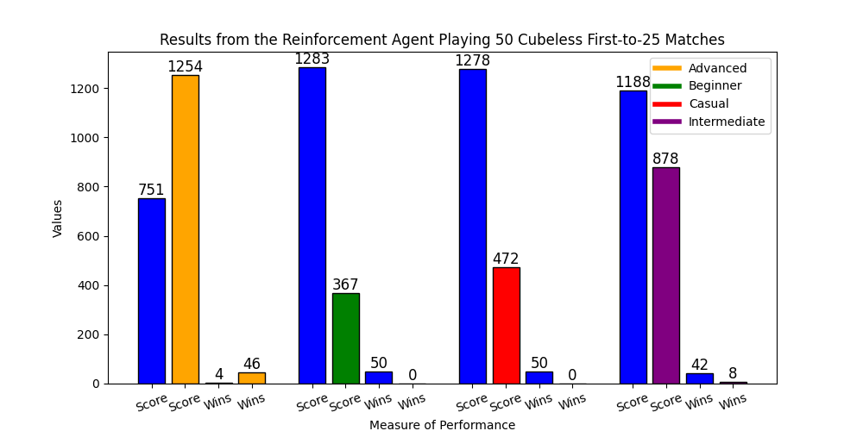
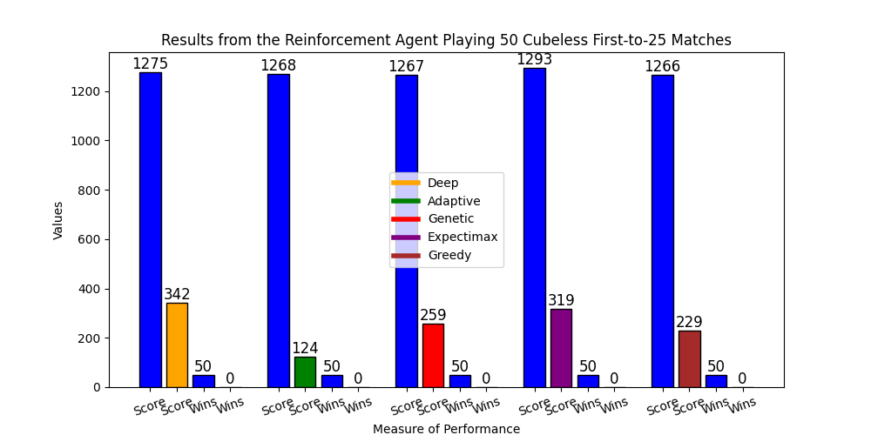
Performance of the Reinforcement Agent
Achieves advanced-level play
Far superior to all other agents presented in this project

Slide 29
Strengths & Weaknesses of the Reinforcement Agent
Strengths:
Contact move-play is highly accurate
Very good at positioning checkers for bearing off when still in contact positions
Almost perfect opening move selection
Incredible long-term strategizing
Leave ‘anchors’ far back when in a losing position to try and hit the opponent off the board
Weaknesses:
Absolute accuracy when predicting outcomes to games
Makes suboptimal decisions in bearoff races

Slide 30
Potential Improvements to Reinforcement Agent
Extend
Extend lookahead to 3-ply
This would likely improve performance in bear-off races where the opponent’s actions no longer affect the AI
Include
Include precomputed features in board encoding
This caused an enormous boost in performance between TD-Gammon 1.0 and TD-Gammon 2.0
Make
Make specialist network for racing positions
Could generate random racing board states and set the agent to play against itself with those board state chosen as the starting board

Slide 31
Evaluation of Agent Doubling Strategies
Agents on average perform better in race positions than contact positions and when offering the cube in comparison to accepting the cube
Offering a double is simpler: it’s easy to see if you’re in a winning position
Accepting/rejecting the cube is more complex: not just about if you’re losing, but by how much you’re losing by and what the likelihood you’ll be able to turn the game around is
 | Deep/Reinforcement | Adaptive | Intermediate
Contact Accept | 74.59% | 63.51% | 39.29%
Contact Offer | 93.39% | 85.06% | 75.63%
Race Accept | 89.32% | 86.69% | 84.06%
Race Offer | 92.31% | 86.80% | 74.81%

Slide 32
So… do agents designed to maximise PPG differential instead of win rate perform better in tournament-style matches?
The results indicate that they do
TD-Gammon 1.0 used a very similar board encoding to the Reinforcement agent and only achieved intermediate-level play
Reinforcement agent attains weak-advanced or advanced-level play
Deep Agent general-purpose model for when in contact positions improves forward planning and gets checkers into better positions for bearing off earlier
Incredibly accurate doubling strategy helps maximise PPG differential and win rate

